Slide 1
Configuring an SD-UX Server
Version A.01
H3065S Module 16 Slides

Slide 2
Why Create an SD-UX Depot Server?
A network SD-UX depot server allows:
clients without CD-ROM drives to install from the network
software from multiple sources to be consolidated in a single location
simplified patch and software management
Good candidates for distribution via a network depot include:
patches
10.x application and core OS software
11.x application and core OS software
application software
a673172

Slide 3
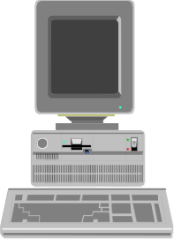
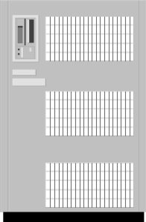
SD-UX Concepts
Network Depot Server
software
Target
/Patchdepot
/CoreOSdepot
/CDdepot
Target
Target
a673174

Slide 4
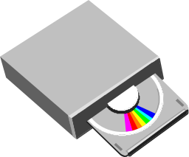

Creating a Depot Server
Registering a CD depot for client access:
# mkdir /CDdepot
# mount /dev/dsk/c0t3d0 /CDdepot
# swreg -l depot @ /CDdepot
Copying software from a CD depot to a disk depot:
# mkdir /cdrom
# mount /dev/dsk/c0t3d0 /cdrom
# swcopy -s /cdrom
swcopy
a673175

Slide 5
Listing Depots and Products
Listing depots:
# swlist -l depot
# swlist -l depot @ minnie
Listing products on a depot:
# swlist -l product -d @ /CDdepot
# swlist -l product -d @ minnie:/CDdepot
a673176

Slide 6
Installing Products from a Depot
swinstall
Target
# swinstall -s minnie:/CDdepot
a673177

Slide 7
Network Depot Auditing
SD-UX maintains a log for each depot that records the following:
Who pulled software?
What software was pulled?
Which revision was pulled?
What is the status of each currently running SD-UX session?
a673178

